Slide 1
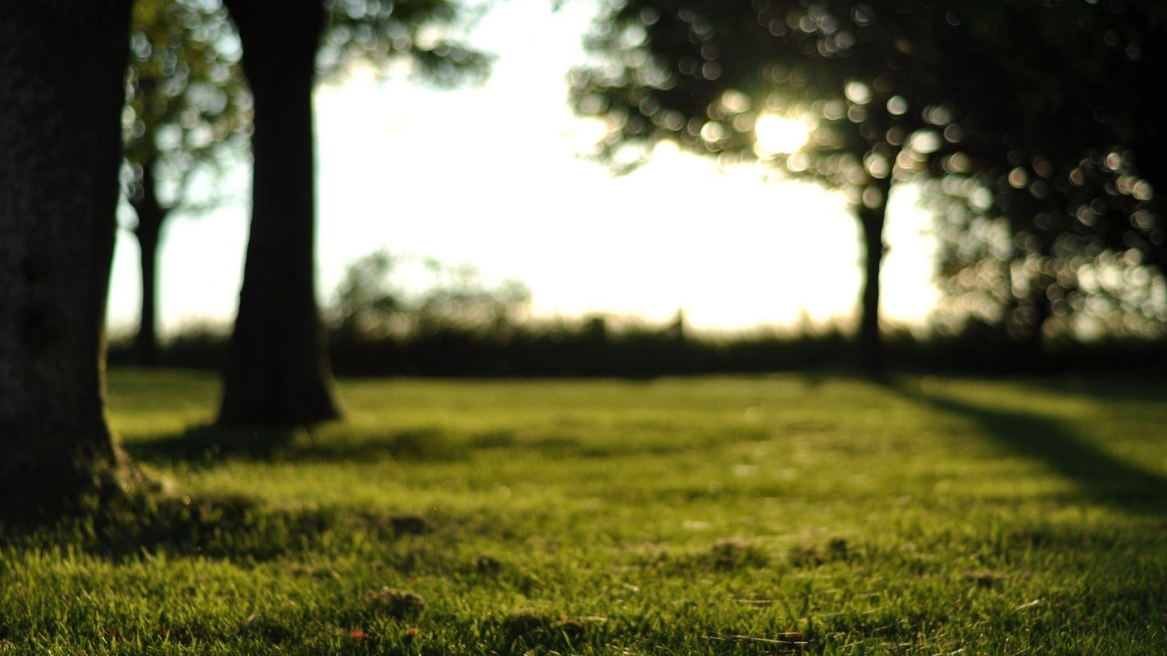
Health Near-sightedness Interactive Medium-Fi Prototype
承洋、際禎、凱捷、George、Wei Yang

Slide 2
Overview
●Raise awareness and ultimately slow down the epidemic of near-sightedness
●Introduce a smart glasses seamlessly notifying user and collecting data of everyday eye activities
●Eye (I) need help: smartGlasses providing users data, notifying them to rest and encouraging good activity to earn rewards.

Slide 3
Three Tasks
1. Detect Distance and Light Intensity, while protecting privacy
2. Automatic or Manual Reminder/Notification
3. Data Cloud, analyzing and summarizing the collected data

Slide 4
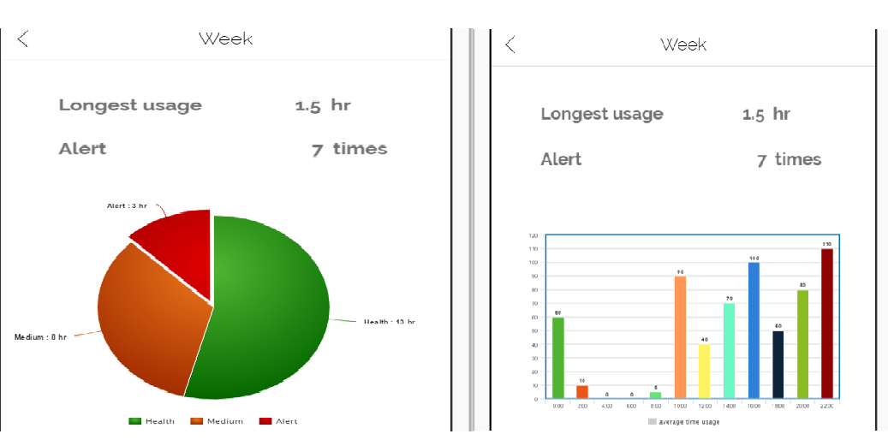
Major Design Changes
The history section can now provide some simple analysis of the collected data.

Slide 5
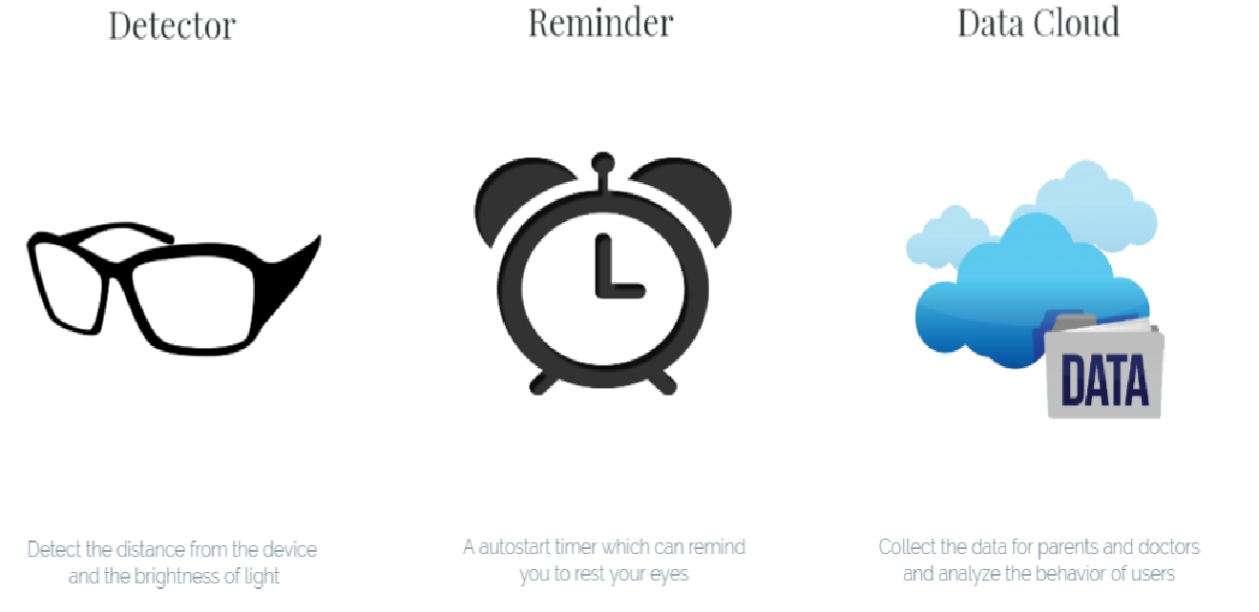
Major Design Changes
2. Briefly introduce functions to the users on first use.

Slide 6
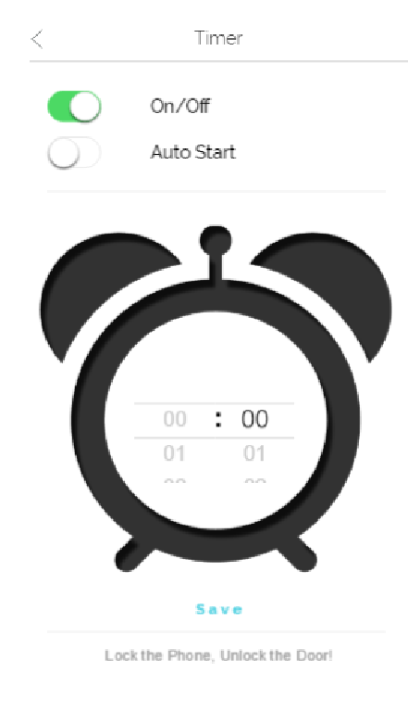
Major Design Changes
3. The timer can start automatically when user is using electronic device.

Slide 7
Medium-Fi Prototype Task Flows
Detect Distance and Light Intensity

Slide 8
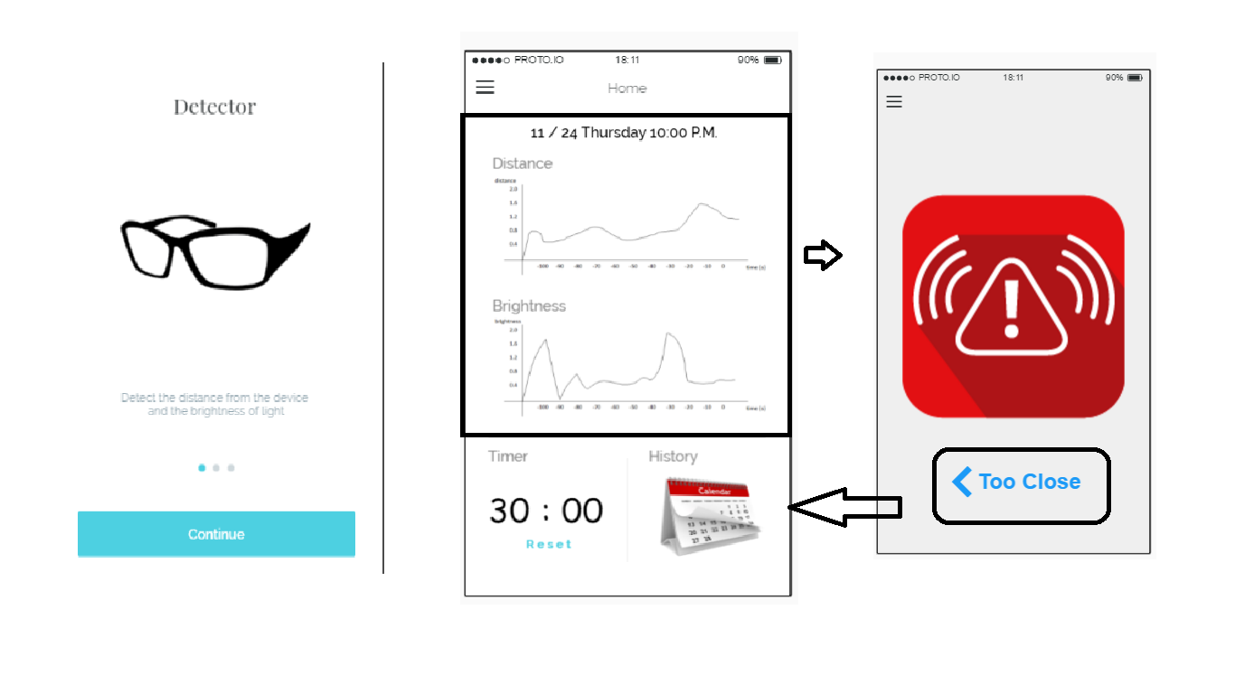

Slide 9
Medium-Fi Prototype Task Flows
2. Automatic Reminder/Notification

Slide 10
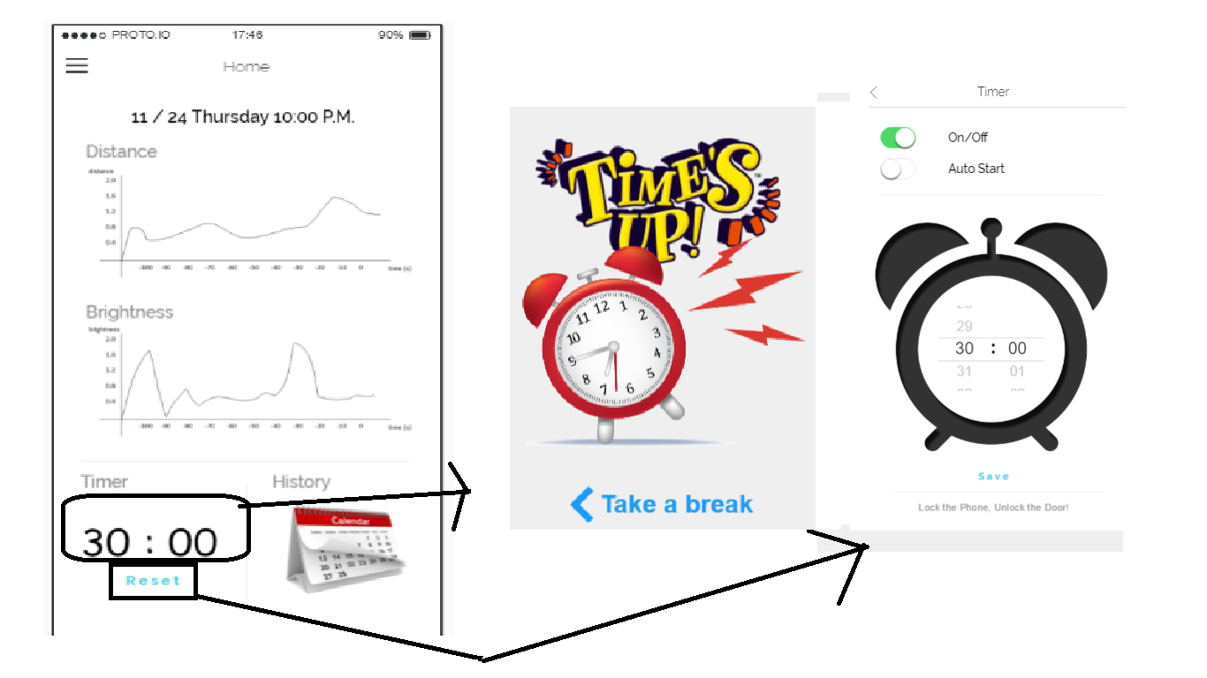

Slide 11
Medium-Fi Prototype Task Flows
3. Analyzing and summarizing the collected data

Slide 12
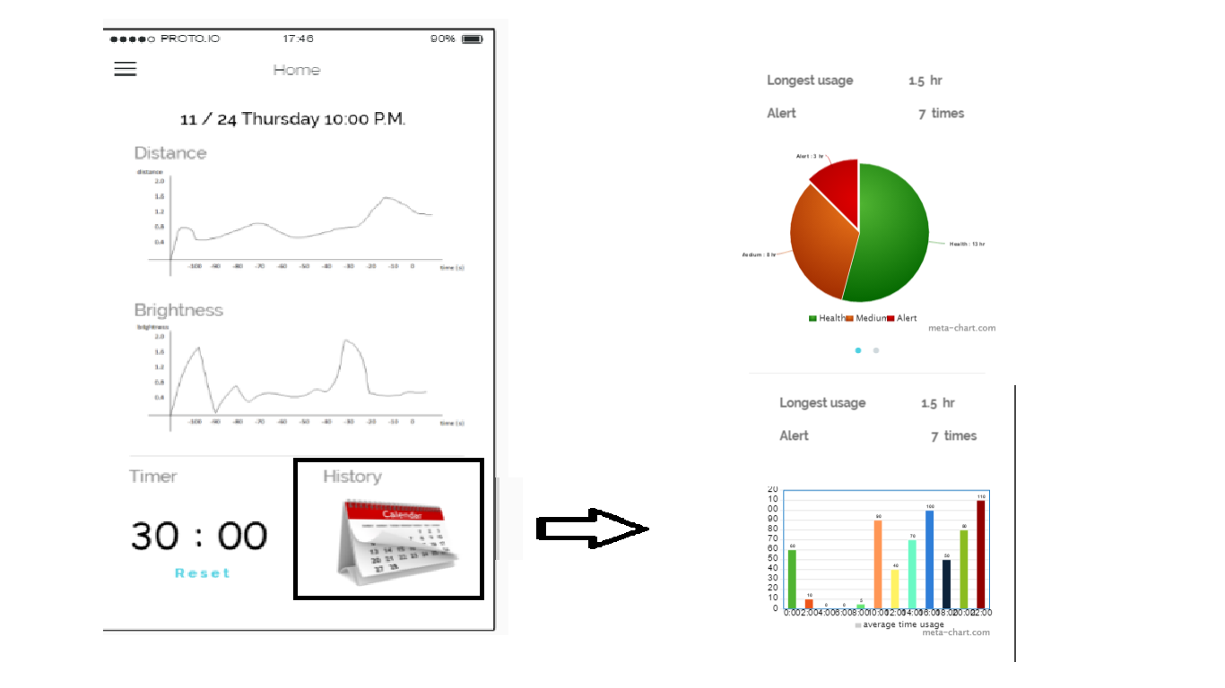

Slide 13
Prototyping Tools ( Proto.io )
How did it help?
With Proto.io, you can visualize your ideas rapidly.
It supports several functions, such as variables calculation and animations.
How did it not help?
It lacks other important functions, such as vibration and data transmission.
Notes:
http://www.csie.ntu.edu.tw/~b04902112/hcid_health/#

Slide 14
Limitations of Current Prototype
History section does not provide long-term analysis
Doctor mode interface has not been implemented
Grading criteria interfaces and message section are under design

Slide 15
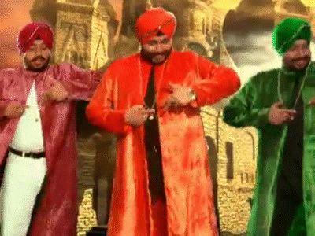
Any Wizard of Oz techniques to make it work
Update data by tapping some hidden buttons
Simulate vibration by shaking users manually

Slide 16
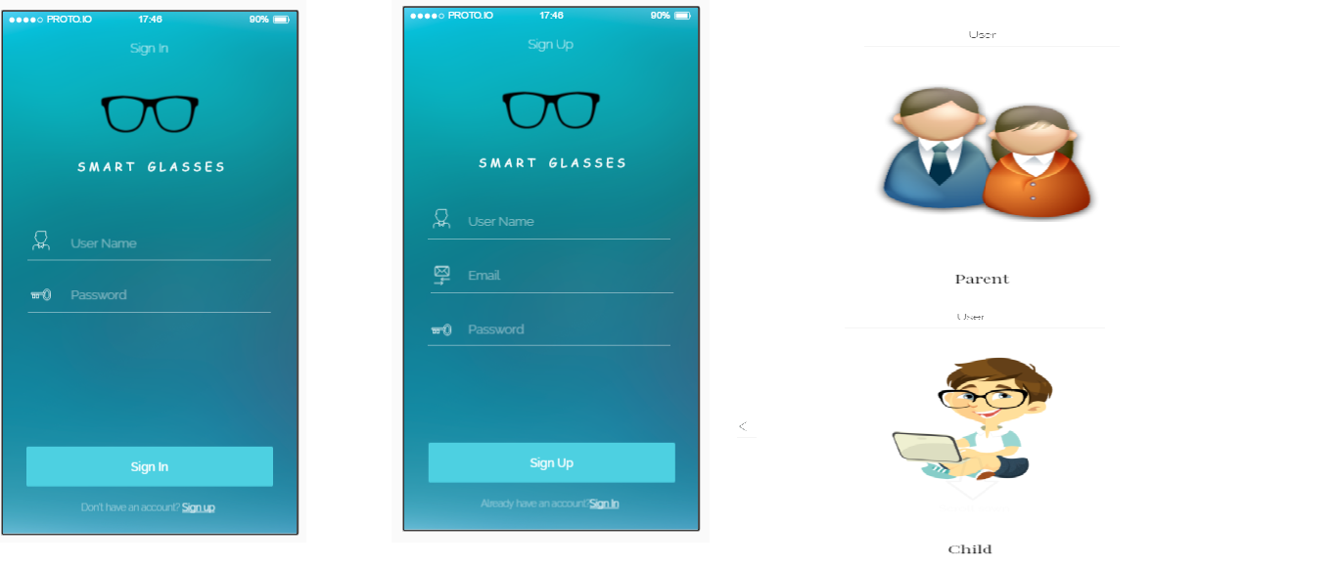
Additional prototype screenshots

Slide 17
http://www.csie.ntu.edu.tw/~b04902112/hcid_health/#

